Slide 1
Zipf’s Law and Text Analysis in Different Corpi
By Daniel Gallab

Slide 2
Introduction: Zipf’s Law and the Kolgomorov-Smirnov Test
Zipf’s law is an empirical law that applies to rank frequency distributions.
While it primarily is used for text, the distribution exists for various natural data, such as populations in cities, or even perhaps comment score distribution
There are many different formulations of Zipf’s law, but the most basic states that the frequency is inversely proportional to its rank.
More specific implementations, such as the power law equation, attempt to fit a zipfian distribution in the form of c/(rank^s), where c and s are constants, and s is the desired exponent
Typically s = 1, and c is the highest frequency, but in certain distributions we may see a much larger s

Slide 3
Continued
The Kolgomorov-Smirnov test generates a statistic
A high KS statistic shows more variation than one would expect from a normal zipfian distribution
The Kolgomorov-Smirnov test uses Maximum Likelihood Estimation to find the best KS statistic
A lower KS statistic tends to show a stronger zipfian distribution, but it will not vary highly.

Slide 4
Exploratory Data Analysis
After considering several datasets, I decided to use the brown corpus and gutenberg corpus as the ideal training set, because of their large sizes and highly differing p-values
I decided to look only at the top 100 most frequent words for both efficiency and accuracy, because the tail can skew the data significantly
I also plotted a different dataset, which shows the ratios of each subsequent word frequency with the one before it
Every one of our 5 ratio plots, when considered in its entirety and not just the first 100 words, exhibit a unique, periodic pattern

Slide 5
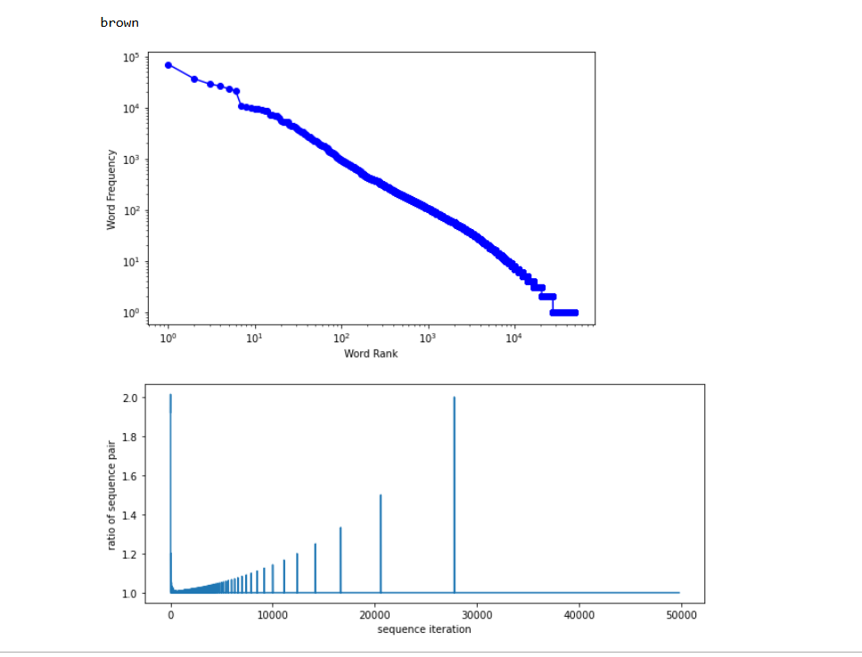
Brown Corpus full (training)

Slide 6
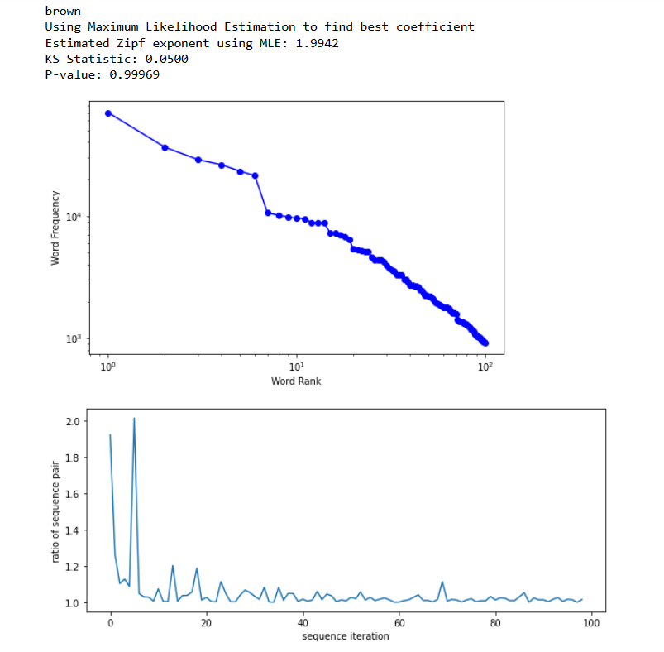
Brown Corpus first 100 (training)
Zipf_exp = 1.9942
P-value = 0.99969
KS_statistic = 0.0500

Slide 7
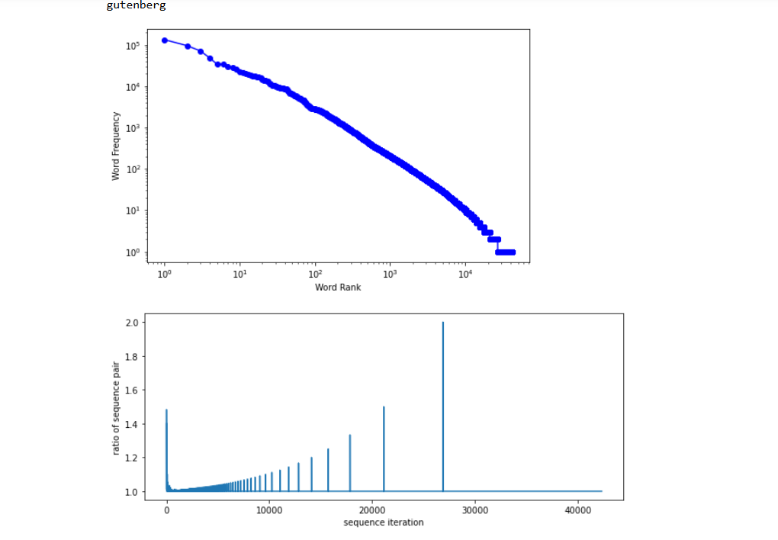
Gutenberg Corpus full (training)

Slide 8
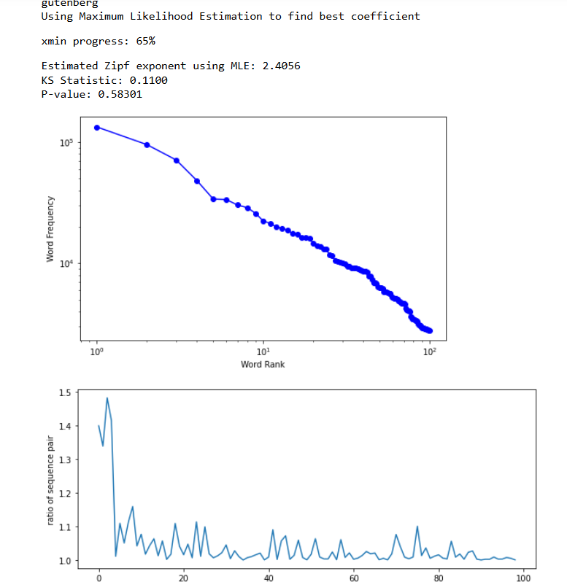
Gutenberg Corpus first 100 (training)
Zipf_exp = 2.4056
P-value = 0.58301
KS_stat = 0.1100
Much lower p-value than that of Brown Corpus but high enough to be significant

Slide 9
Extrapolating from Training Data
note that the full distributions do not calculate the zipf coefficient because of efficiency reasons (It can however find a p-value if given an estimated zipf exponent of 1, if the user desires)
The brown corpus, despite being smaller than the gutenberg corpus, is fit quite well using Zipf’s law
The gutenberg corpus has a much smaller p-value but it remains high enough to imply a zipfian distribution
Gutenberg has more classics and artistic writing style than Brown corpus, possibly explaining its lower p-value

Slide 10
Choosing Test Data Sets
For our test sets, we chose 3: Shakespeare’s plays, modern poetry, and Reuters news articles.
We suspect reuters to have a higher p-value than shakespeare and modern poetry
We suspect the higher the p_value, the lower the KS statistic

Slide 11
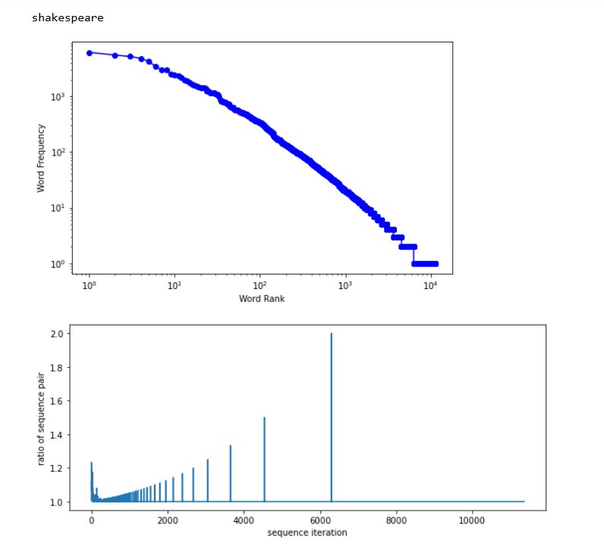
Shakespeare Corpus full (test)

Slide 12
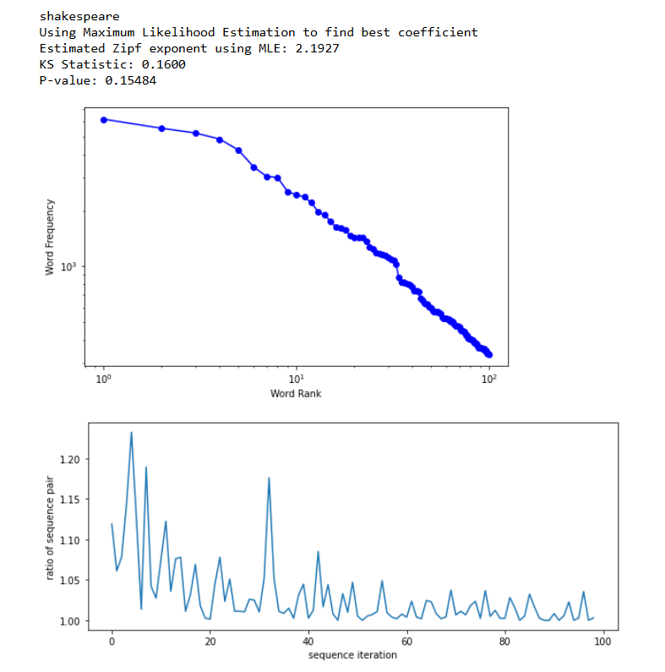
Shakespeare Corpus first 100 (testing)
Zipf_exp = 2.1927
P-value = 0.15484
KS_statistic = 0.1600

Slide 13
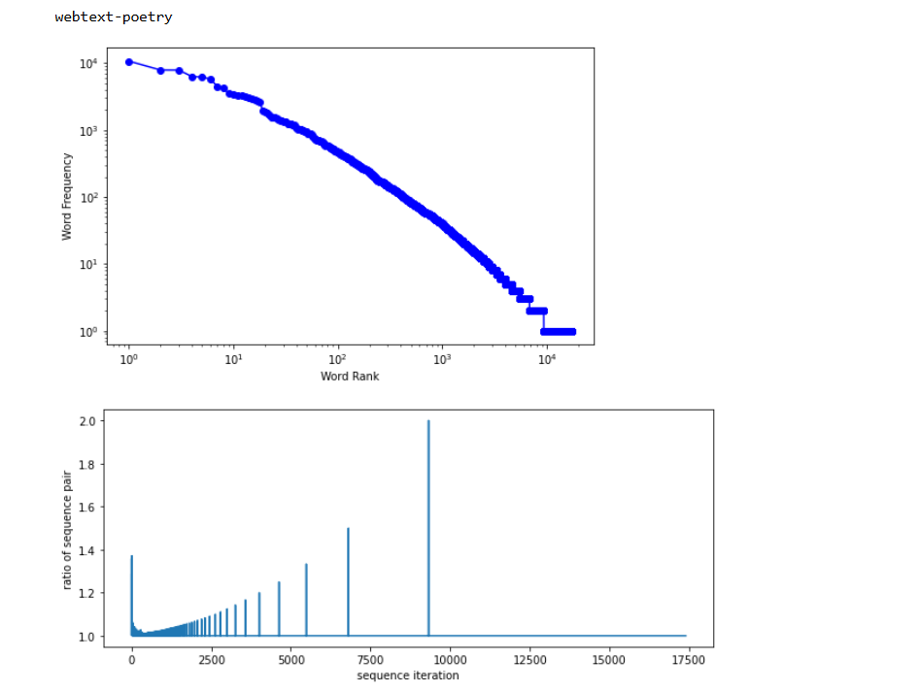
Webtext Poetry full (testing)

Slide 14
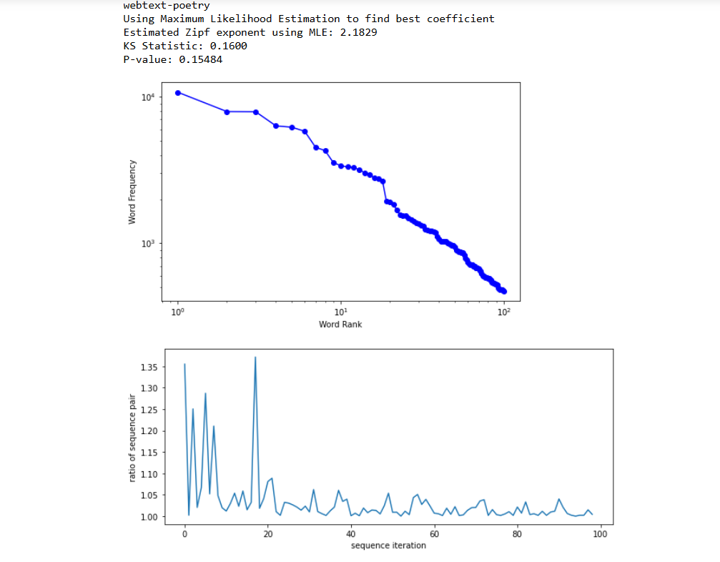
Webtext Poetry first 100 (testing)
Zipf_exp = 2.1829
P-value = 0.15484
KS_stat = 0.1600

Slide 15
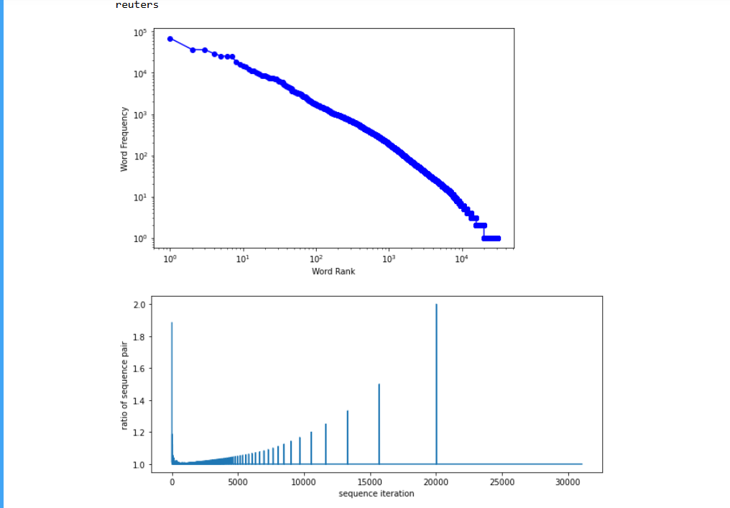
Reuters Corpus full (testing)

Slide 16
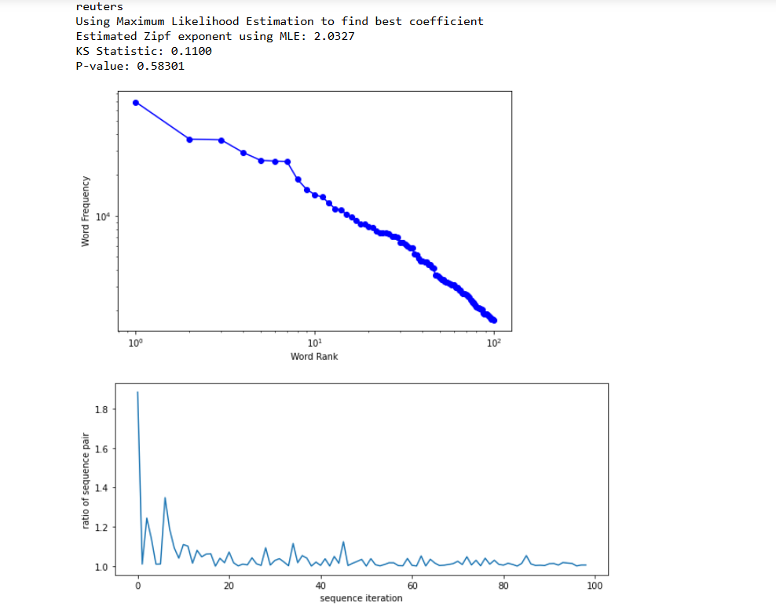
Reuters Corpus first 100 (testing)
Zipf_exp = 2.0327
P-value = 0.58301
KS_stat = 0.1100
Relatively high p value shows zipfian distribution, although not as strong as the brown corpus

Slide 17
Discussion Summary
Both Shakespeare’s plays and modern poetry demonstrate lower p values as suspected
While the Reuter corpus did not have a p value of nearly 1 like the brown corpus, it was still significantly higher than that of poetry or Shakespeare
One can indeed analyze zipfian distributions in text in order to deduce writing style
Yet preparing adequate datasets can be challenging
Ambiguity of genre
Low amount of data from single authors with a few exceptions
Differing total word count
We also found that the the KS statistic tends to be lower the higher p is, but the variation is much smaller

Slide 18
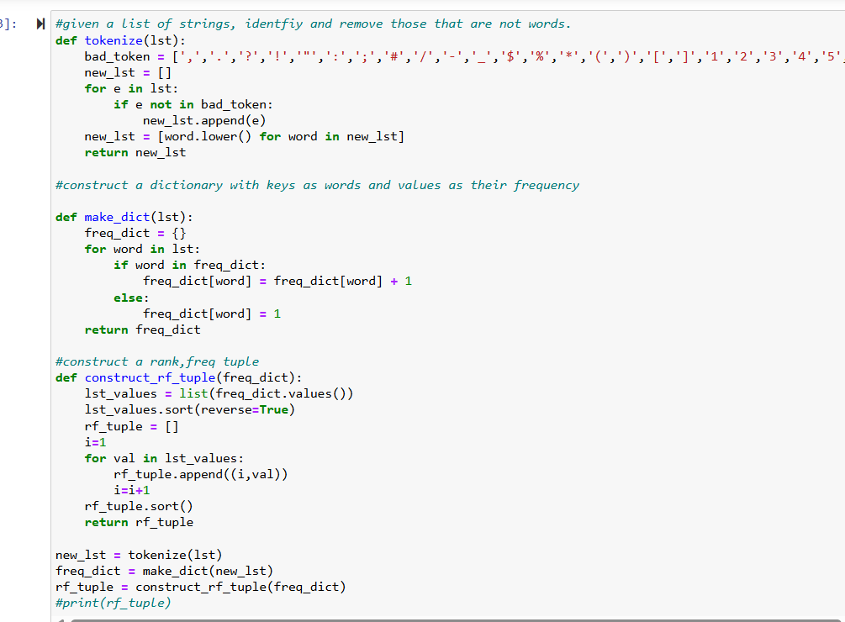
code examples: cleaning the data

Slide 19
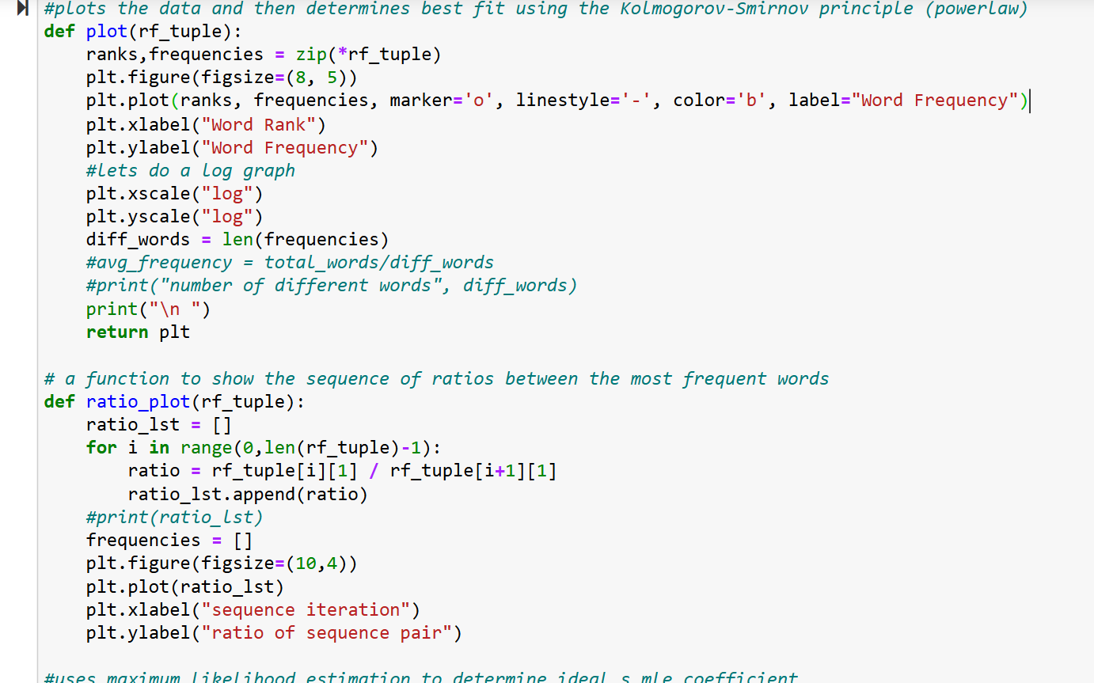
Code: plot

Slide 20
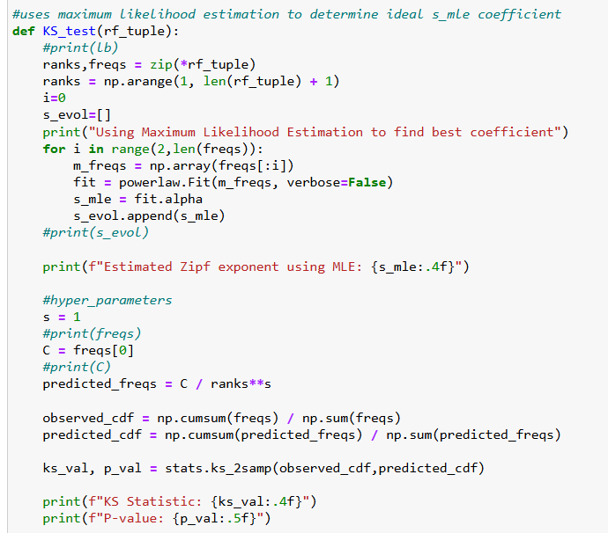
Code: KS fitting

Slide 21
References and Notes
Used nltk libraries to retrieve corpi
Did basic research on zipf’s law, the KS test
All code is of my own structure and design
More details in python file

